Slide 1
InfoMagNav: Real-Time Uncertainty-Aware Motion Planning for Magnetic-Based Navigation
By Aditya Penumarti
April 3rd, 2026

Slide 2
Motivation and Background

Slide 3
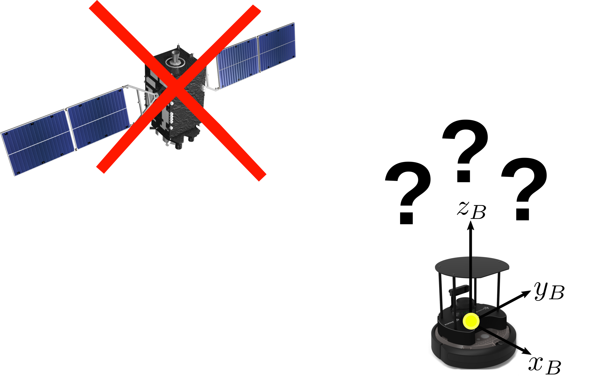
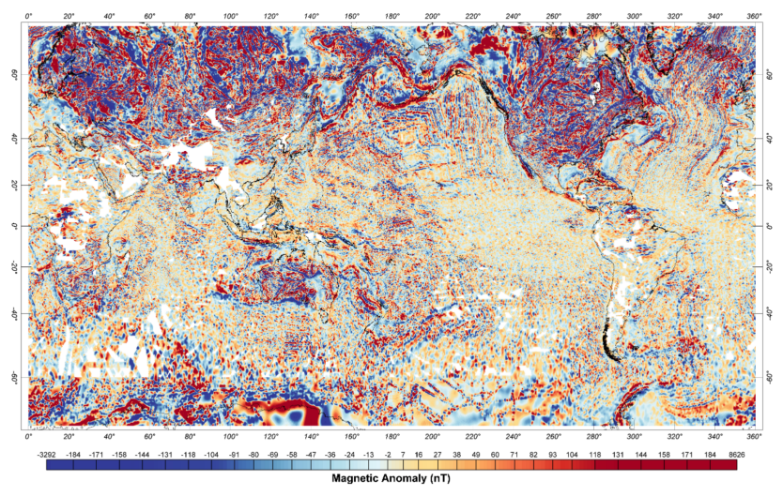
Motivation: Magnetic Anomaly-based Navigation (MagNav)
Long-duration operation without GPS
Magnetic Anomaly map
GPS not available (jammed)
Weather-dependent
Not robust in repeated features
Available globally
Robust to dynamic changes unlike magnetic fields
How can we utilize magnetic anomalies for GPS-denied navigation?

Slide 4
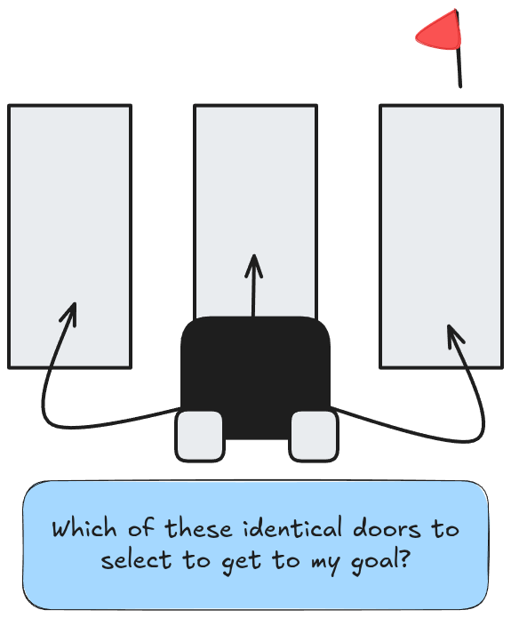
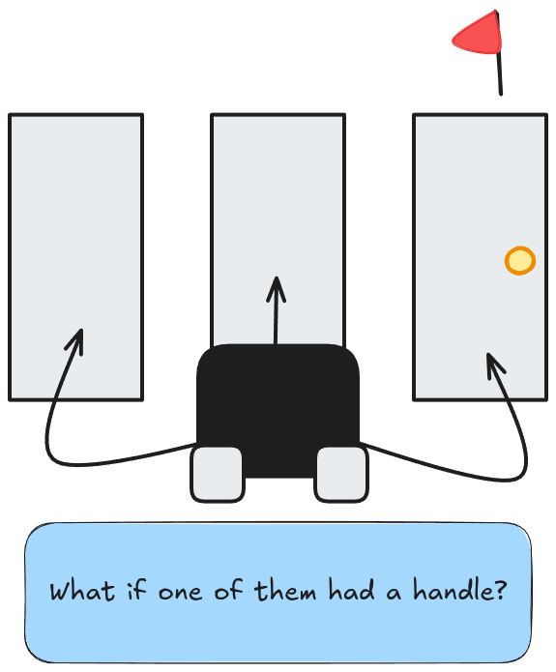
Motivation: Uncertainty Reduction
How can we use information encoded in our environment to make better navigation decisions for our localization?

Slide 5
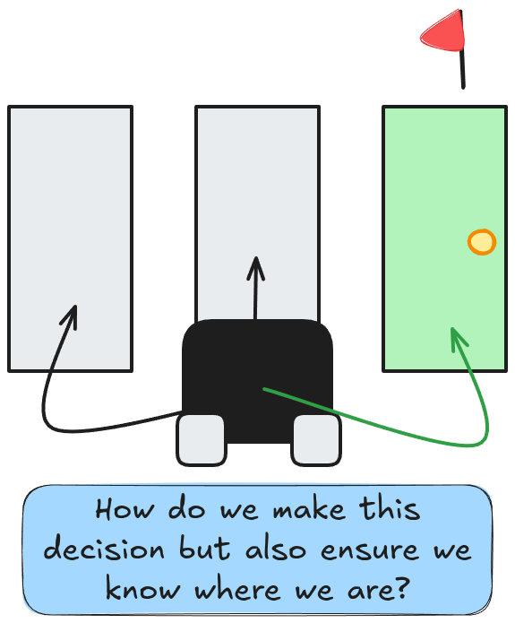
The Problem
Using information can we reduce our uncertainty about our state while completing our task?
Use the information available to make decisions
These decisions as a consequence will help us know where we are

Slide 6
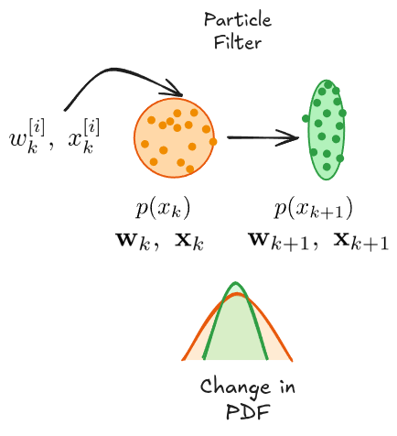
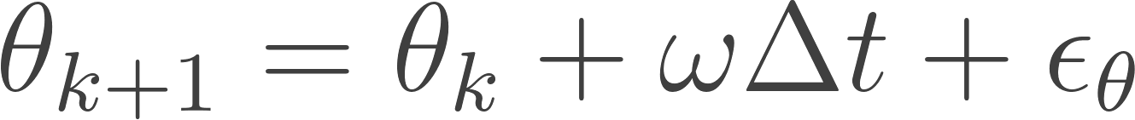
Background - Particle Filter
Particle Filtering [1] is used to localize in magnetic fields
The filter has state estimate guesses initialized as:
  a standard normal distribution with uniformly distributed weights
The filter is propagated using a unicycle motion model
Fig. 2: Particle Filter Architecture
[1] F. Dellaert, D. Fox, W. Burgard, and S. Thrun, “Monte Carlo localization for mobile robots,” in Proceedings 1999 IEEE International Conference on Robotics and Automation (Cat. No.99CH36288C), May 1999, pp. 1322–1328 vol.2. doi: 10.1109/ROBOT.1999.772544.

Slide 7
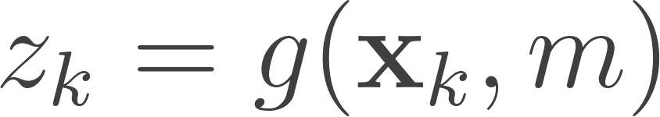
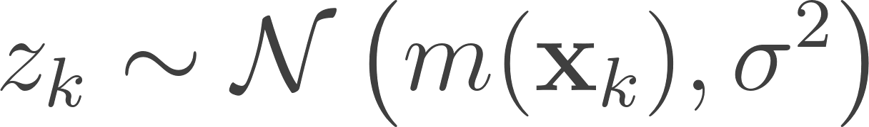
Background - Particle Filter
Sensor model is a queried map sensor value with stochastic noise:
This sensor model is then used to update the state estimate based on the prior distribution.
The localization is highly dependent on where the anomalies are
Fig. 2: Particle Filter Architecture

Slide 8
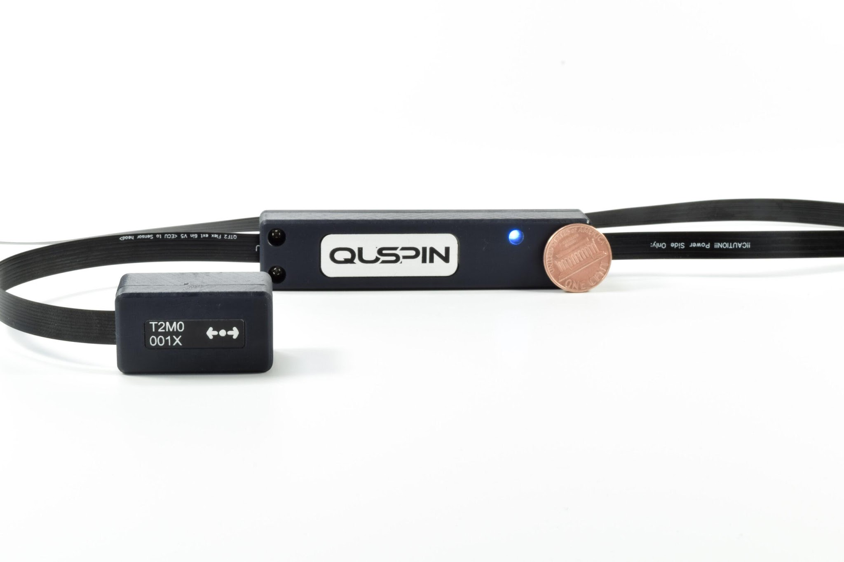
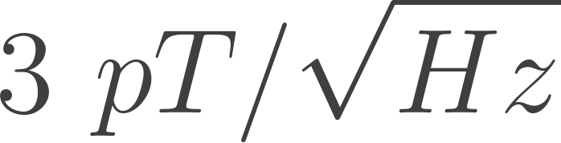
Background - Map Collection
MagNav requires highly sensitive magnetometers to be used
  An optically pumped quantum magnetometer is used
The magnetometer produces a scalar intensity output
The sensitivity of the magnetometer used is
QTFM Magnetometer (https://quspin.com/qtfm-gen-2/)

Slide 9
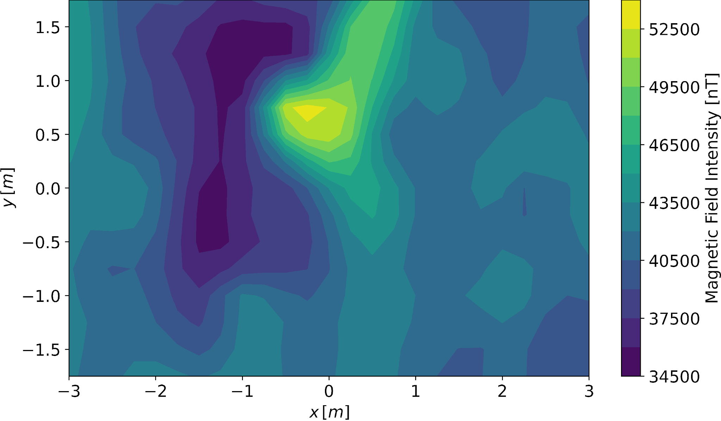
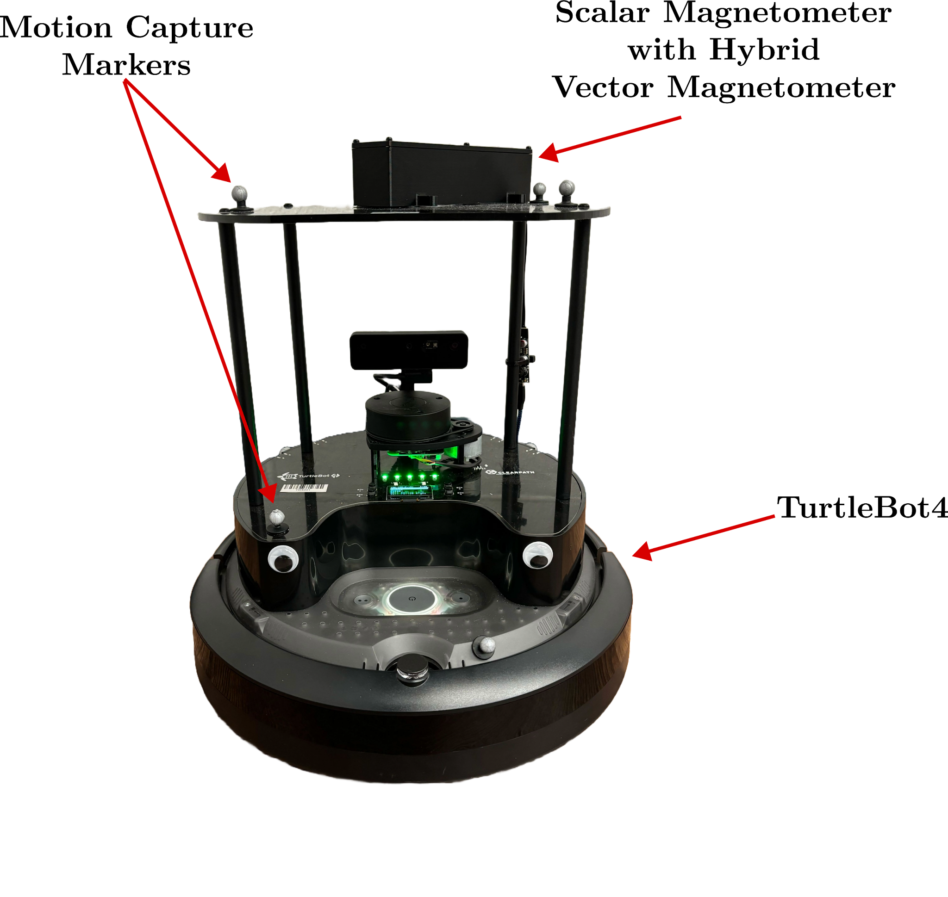
Background - Map Collection

Slide 10
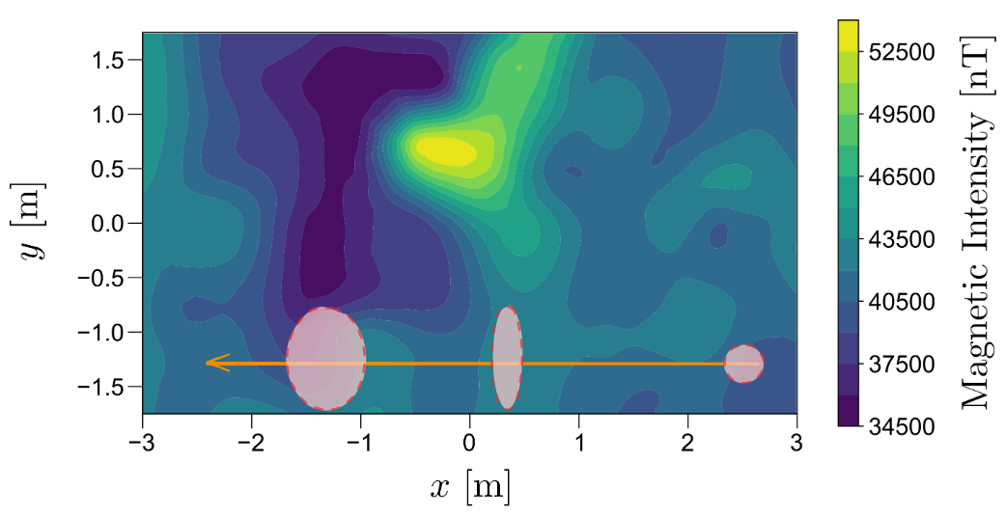
Background - MagNav Localization
Fig. 3: Navigation through uniform/flat gradients
Navigating through low gradients the uncertainty increases as there is no uniqueness.

Slide 11
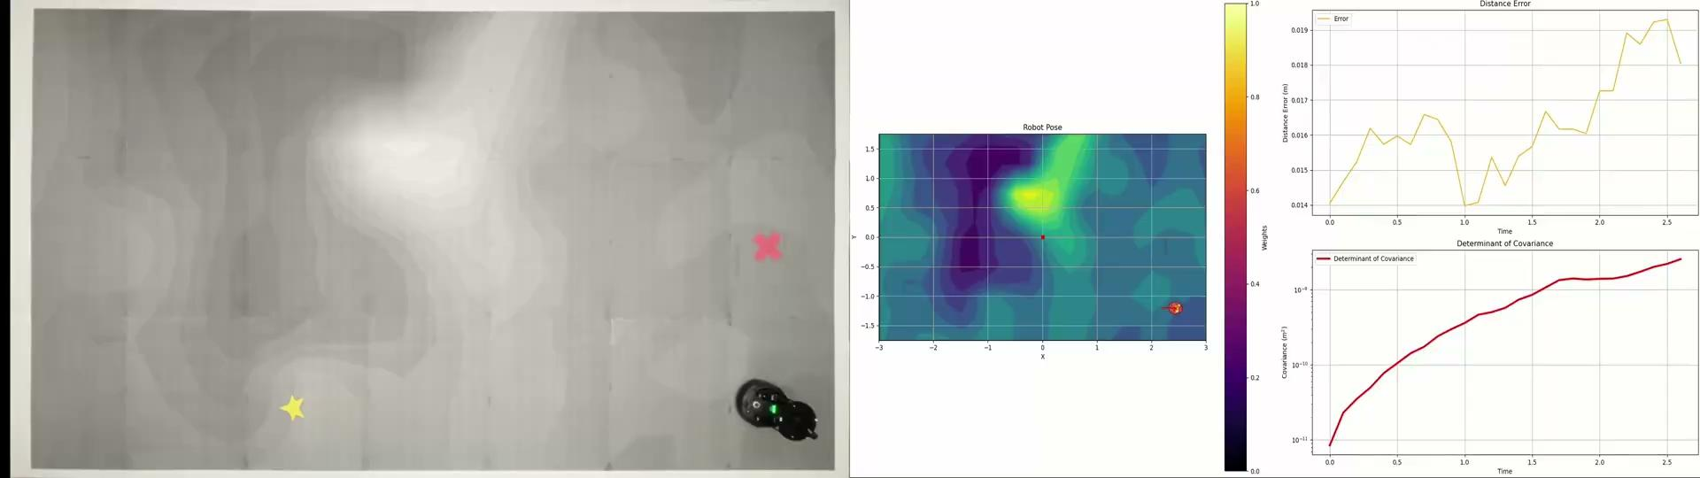
Background - MagNav Localization
Navigating through low gradients the uncertainty is increased.
Localization is completed using a particle filter.

Slide 12
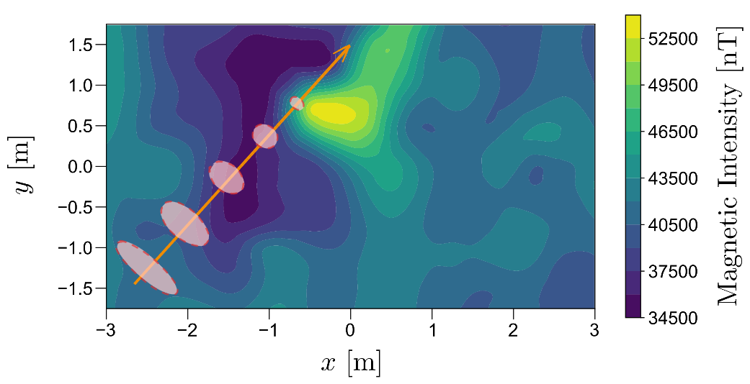
Background - MagNav Localization
Fig. 4: Navigation through spatial varied gradients
Navigating through high gradients the uncertainty is reduced.

Slide 13

Background - MagNav Localization
Navigating through high gradients the uncertainty is reduced.
Using a particle filter the localization algorithm is completed.

Slide 14
Methodology

Slide 15
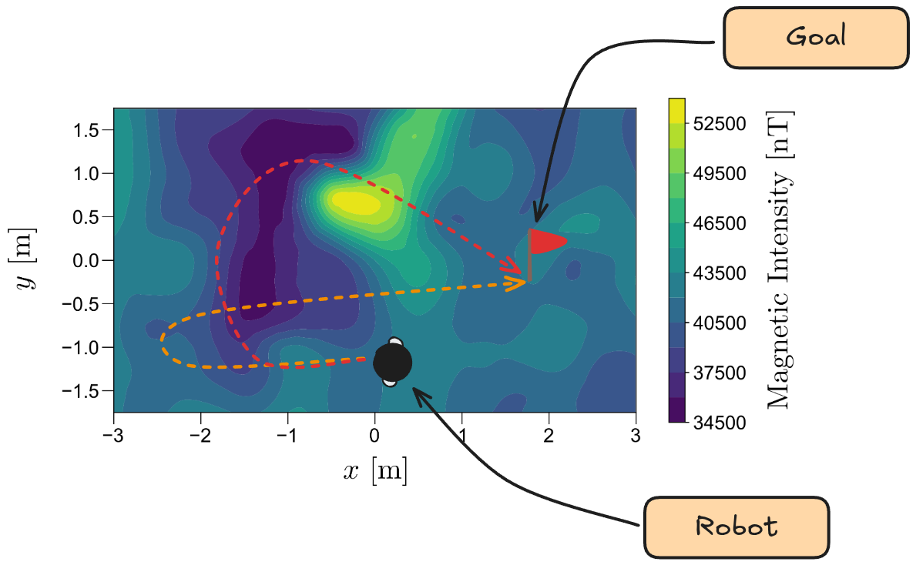
Methodology - Uncertainty-Aware MagNav
Fig. 6: Leveraging the gradients in the magnetic anomaly map, the robot will be able to make intelligent actions to reach the goal.
Using the information-rich magnetic anomaly map, can we navigate through the magnetic fields intelligently to improve localization?

Slide 16
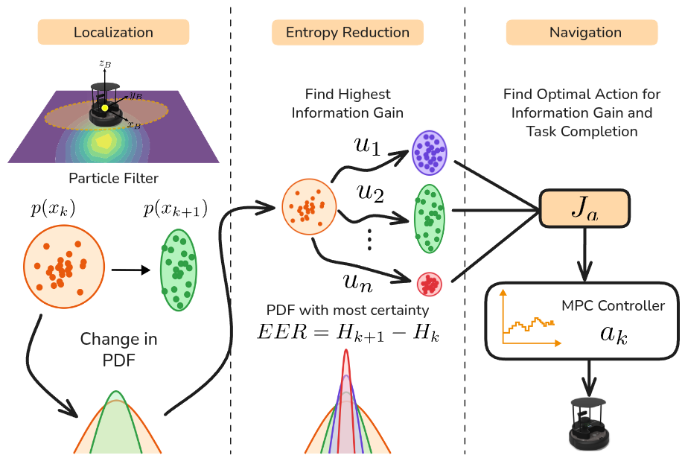
Methodology - Uncertainty-Aware MagNav
Fig. 7: Architectural overview of InfoMagNav for the uncertainty-aware navigation

Slide 17
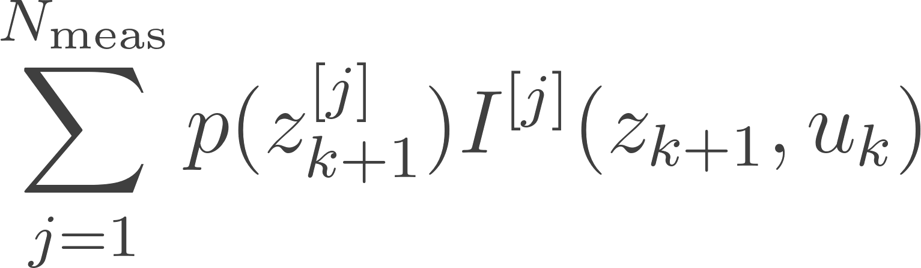
Methodology - Information Gain
The method uses the entropy from the previous action and entropy from the current action to calculate Information Gain:
As we want to predict the next best action to taken, we need the expectation over all the future sensor measurements with respect to information gain to calculate the Expected Entropy Reduction :
For efficient calculation, the particles from the filter can be used to calculate the EER:

Slide 18
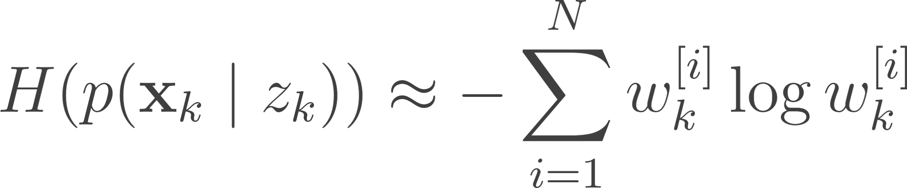
Methodology - Entropy Approximation
The approximation for the entropy is a computationally intractable problem, largely due to the estimation of the evidence term.
To combat this the particle filter is leveraged to estimate the entropy from the state-estimation distribution
Often naively the following formula is used:
Often in a low-dimensional feature space like MagNav, simply accounting for the weights is misleading

Slide 19
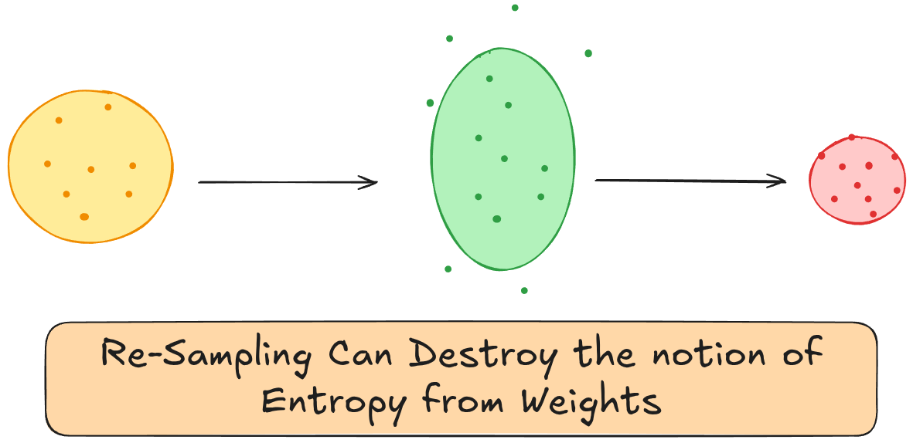
Methodology - Entropy Approximation
The resampling step, as it discards and clusters highly weighted particles can destroy the notion of entropy, if it was solely dependent on weights.
Instead a position, sensor and weight based entropy is used [2]
Fig. 8: Resampling step destruction of information
[2] Y. Boers, H. Driessen, A. Bagchi, and P. Mandal, “Particle filter based entropy,” in 2010 13th International Conference on Information Fusion, Jul. 2010, pp. 1–8. doi: 10.1109/ICIF.2010.5712013.

Slide 20
Methodology - Entropy Approximation
Particle estimation gives us good convergence to the true distribution and maintains the notion of spatial variance affecting information available. [2]
[2] Y. Boers, H. Driessen, A. Bagchi, and P. Mandal, “Particle filter based entropy,” in 2010 13th International Conference on Information Fusion, Jul. 2010, pp. 1–8. doi: 10.1109/ICIF.2010.5712013.

Slide 21
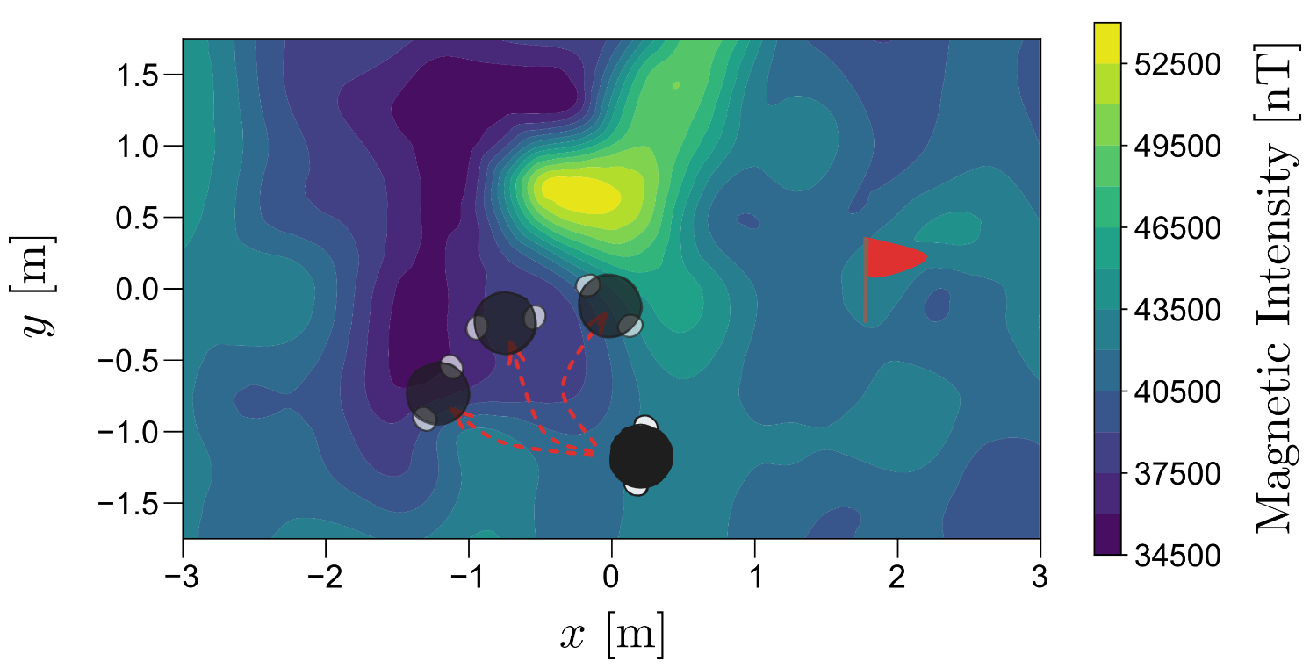
Methodology - Action Selection
To navigate to the goal a receding-horizon based optimization is deployed.
  The system optimizes between exploitation (goal-reachability) and exploration (uncertainty-reduction).
Optimizing over multiple objectives gives us a intelligent navigation algorithm that maintains a certain localization belief.
Fig. 9: Receding-horizon based optimization for navigation with exploitation and exploration

Slide 22
Experiments

Slide 23
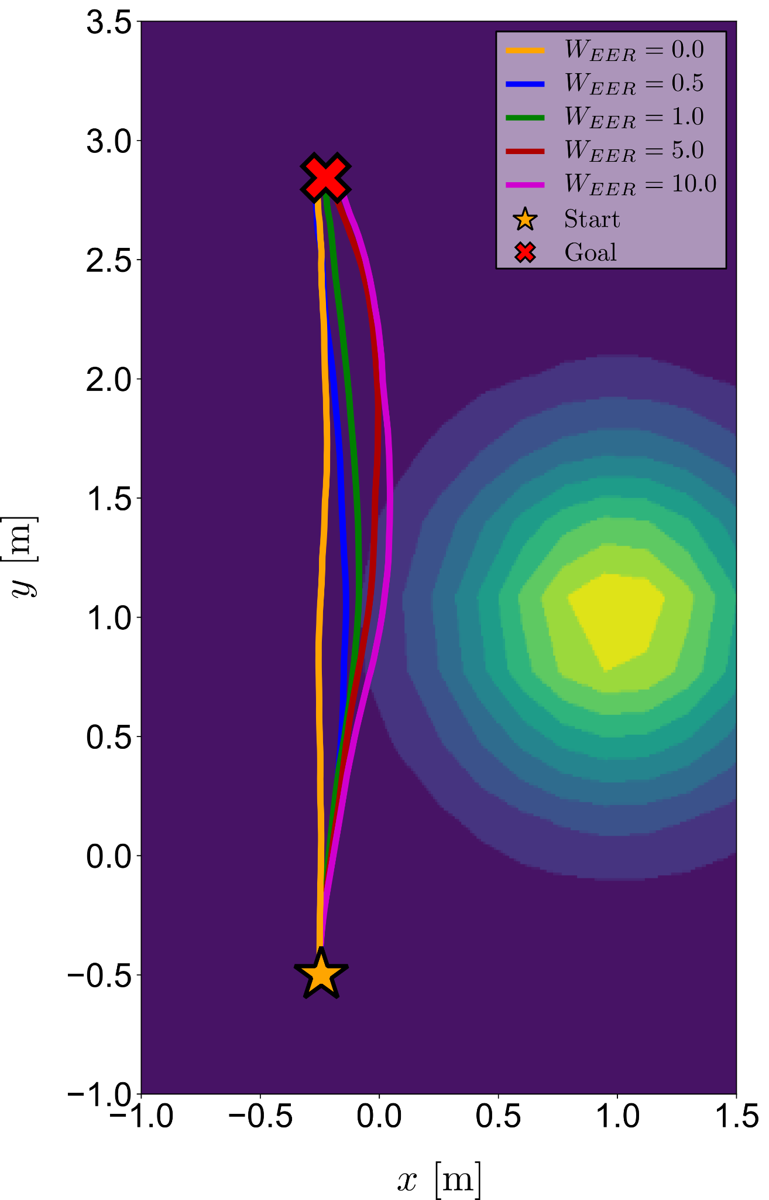
Experiments - Case Study
Planning algorithm considers uncertainty measurements more with a higher weight
When information in unweighted the robot trajectory is almost a straight line
When the localization uncertainty is weighted more heavily in the objective function, the estimation covariance is significantly reduced, leading to lower covariance over time

Slide 24
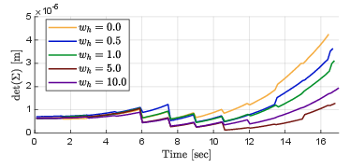
Experiments - Case Study
Planning algorithm considers uncertainty measurements more with a higher weight
When information in unweighted the robot trajectory is almost a straight line
When the localization uncertainty is weighted more heavily in the objective function, the estimation covariance is significantly reduced, leading to lower covariance over time

Slide 25
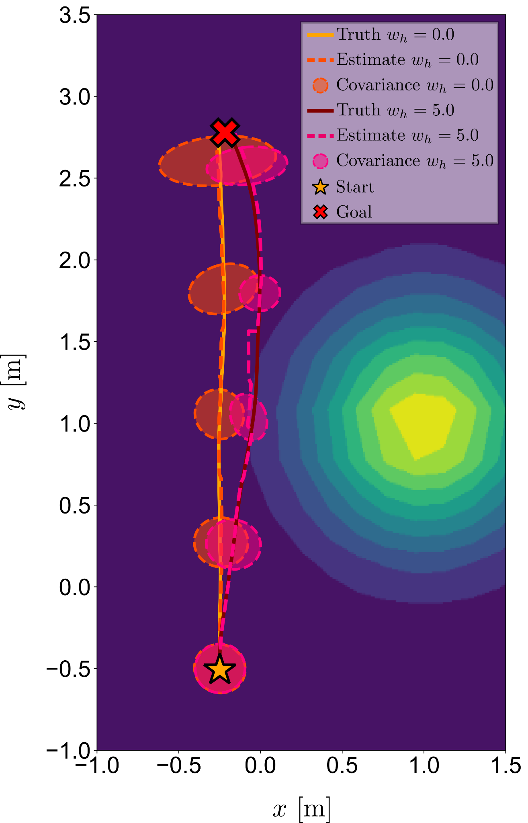
Experiments - Case Study
A second study with no information weight and high information weight indicate uncertainty movement
The trajectory generated with no weight has a larger covariance due to the uniform magnetic field across the area through which the straight trajectory passes
With high weight the covariance initially increases; however, as the robot navigates the edge of the gradient, the covariance significantly improves

Slide 26
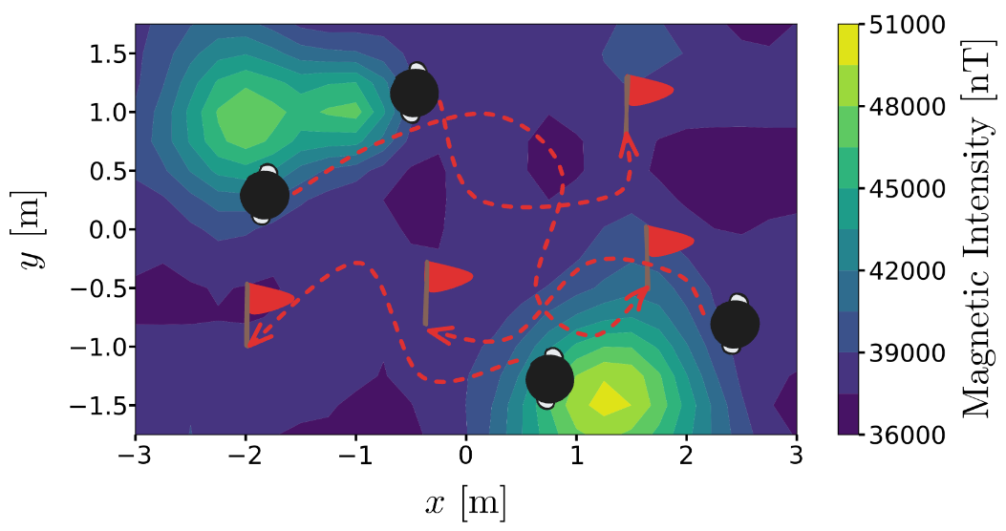
Experiments — Simulation
The method is validated inside a simulation environment that has:
a map with distinct anomalies
randomly selected start and end positions
and robot and sensor modeled on hardware we have available
The simulated experiments consist of Monte Carlo runs to statistically validate localization performance improvements.
Fig. 10: Monte-Carlo simulation for the navigation algorithm for completion of statistical validation.

Slide 27
Experiments — Simulation Results
Algorithm | RMSE X (m) ↓ | RMSE Y (m) ↓ | Tr. Stat Cov (m²) ↓ | Completion Rate (%) ↑ | Computation Time (ms) ↓
Baseline Methods
Graph | 0.0803 | 0.0410 | 0.0051 | 100 | 537.559
MPC Goal Con. | 0.0747 | 0.0419 | 0.0055 | 100 | 3.4382
Information Driven Methods
Info-Gain Greedy | 0.0898 | 0.1118 | 0.0251 | 56 | 33.0905
E-RRT | 0.0799 | 0.0849 | 0.0137 | 94 | 96.1154
DPSolver | 0.0588 | 0.0492 | 0.0042 | 64 | 537.621
InfoMagNav | 0.0610 | 0.0451 | 0.0040 | 98 | 3.2816

Slide 28
Experiments — Simulation Results
Algorithm | RMSE X (m) ↓ | RMSE Y (m) ↓ | MAE X (m) ↓ | MAE Y (m) ↓ | Tr. PF Cov (m²) ↓ | Tr. Stat Cov (m²) ↓ | Completion Rate (%) ↑
Baseline Methods
Graph | 0.0803 | 0.0410 | 0.0600 | 0.0300 | 0.0019 | 0.0051 | 100
MPC Goal Con. | 0.0747 | 0.0419 | 0.0601 | 0.0305 | 0.0016 | 0.0055 | 100
Information Driven Methods
Info-Gain Greedy | 0.0898 | 0.1118 | 0.0683 | 0.0826 | 0.0017 | 0.0251 | 56
E-RRT | 0.0799 | 0.0849 | 0.0595 | 0.0616 | 0.0015 | 0.0137 | 94
DPSolver | 0.0588 | 0.0492 | 0.0485 | 0.0367 | 0.0019 | 0.0042 | 64
InfoMagNav | 0.0610 | 0.0451 | 0.0498 | 0.0323 | 0.0016 | 0.0040 | 98

Slide 29
Experiments — Simulation Results
Algorithm | Path Length (m) ↓ | Computation Time (ms) ↓
Baseline Methods
Graph | 2.8147 | 537.559
MPC Goal Con. | 3.0779 | 3.4382
Information Driven Methods
Info-Gain Greedy | 3.3252 | 33.0905
E-RRT | 3.5616 | 96.1154
DPSolver | 3.1576 | 537.621
InfoMagNav | 3.0639 | 3.2816

Slide 30
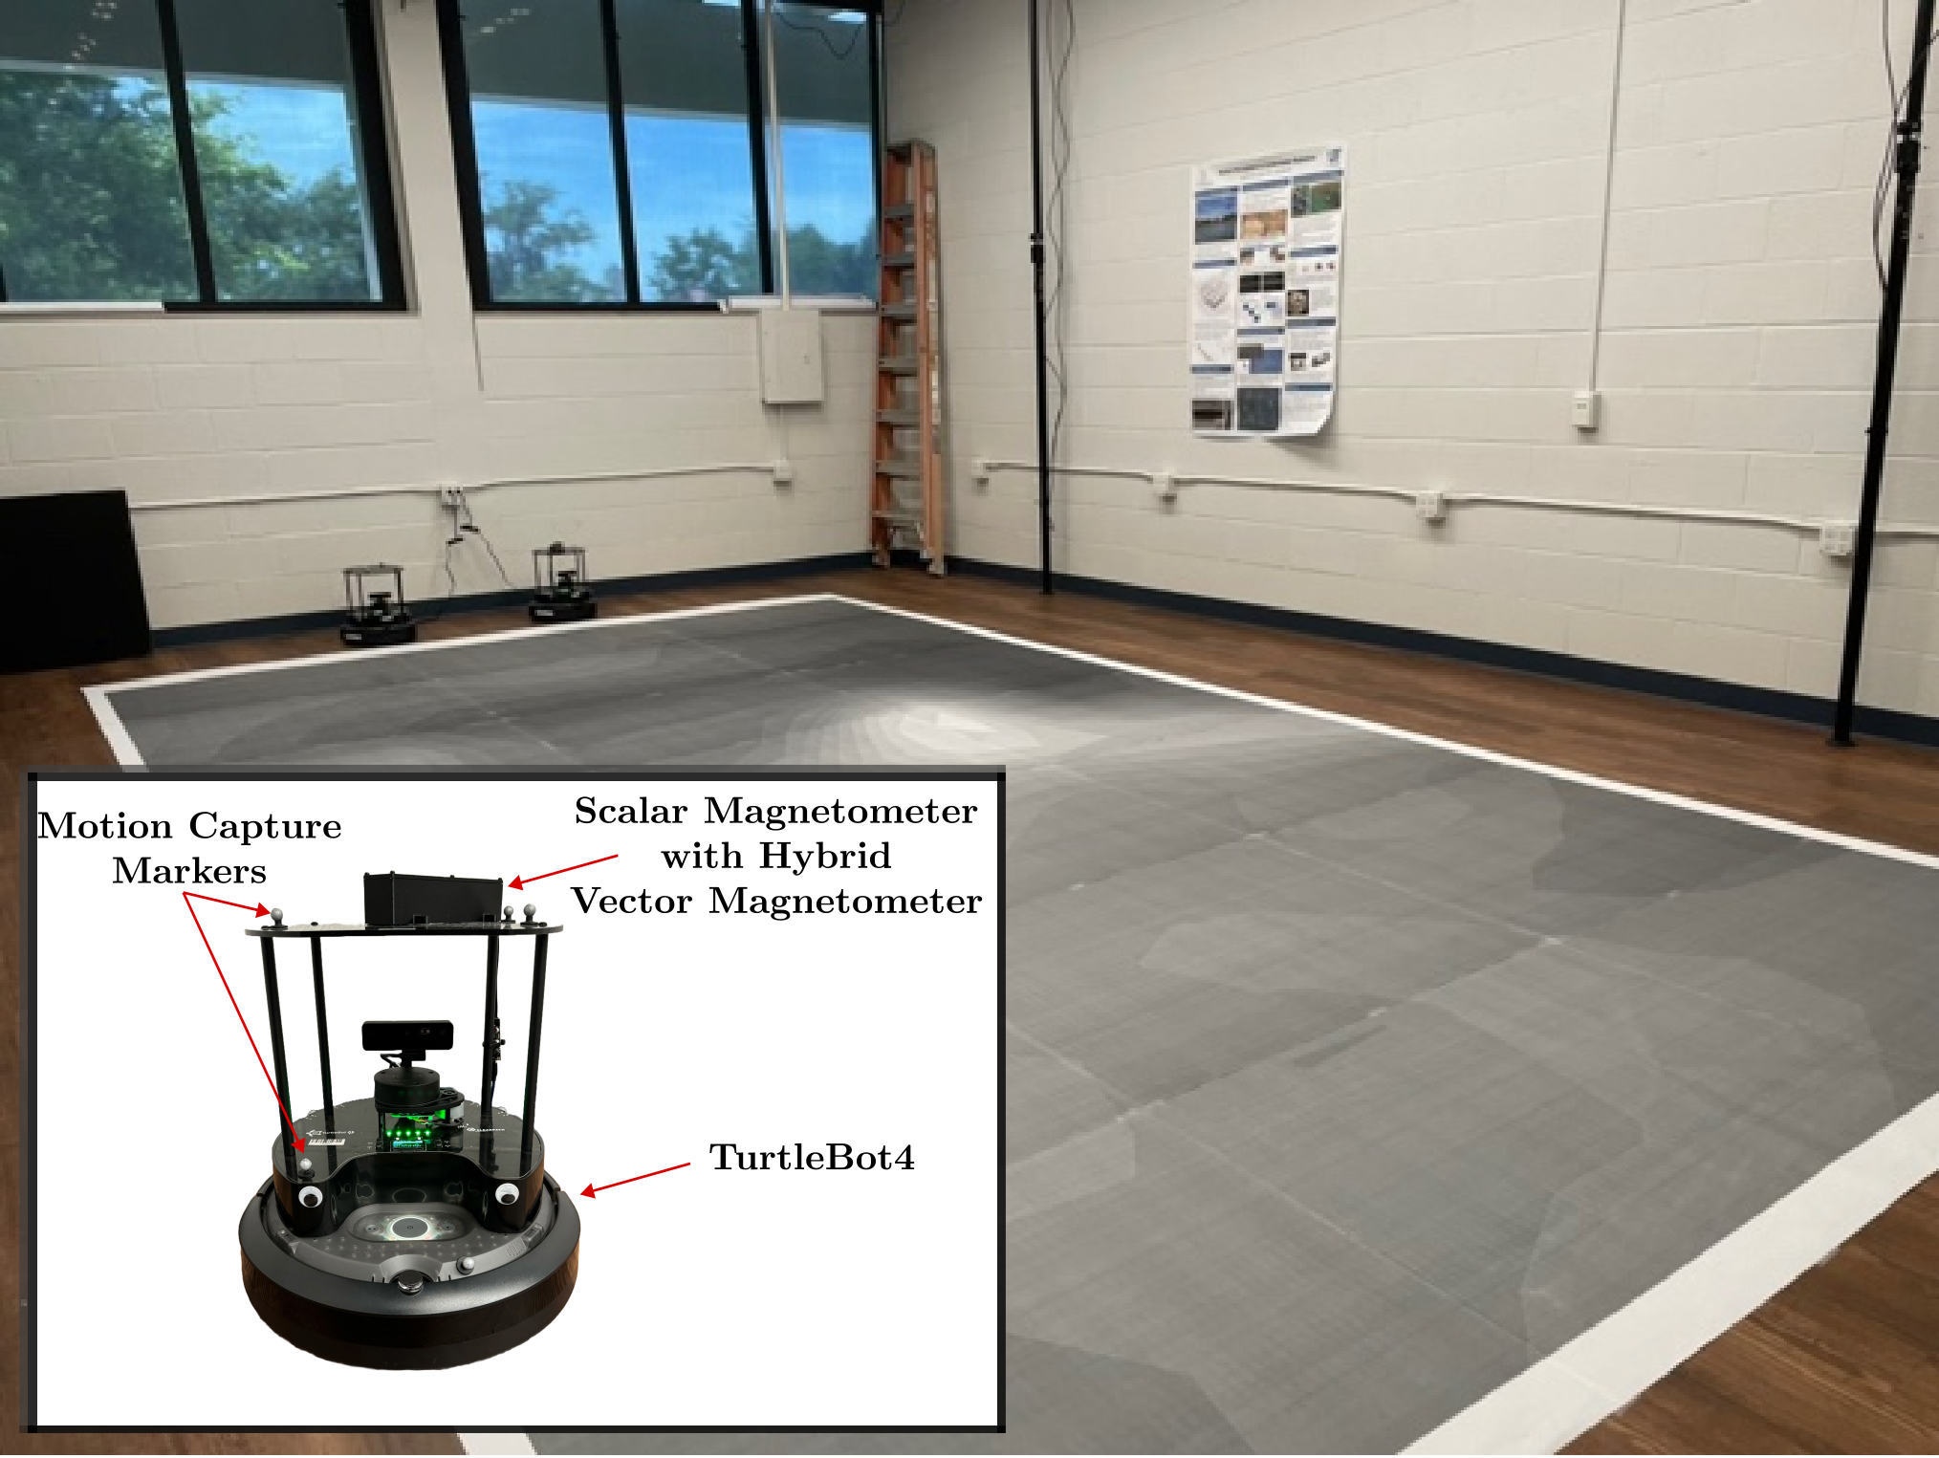
Experiments — Hardware
The method is run in an indoor setting for real-time hardware validation
The robot is equipped with a quantum magnetometer for magnetic anomaly detection
The robot is tracked using a motion capture system for ground truth
Fig. 10: Hardware experimental setup

Slide 31
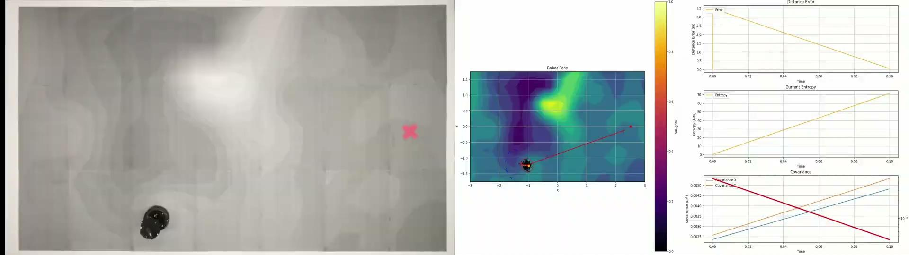
Experiments — Hardware Demonstration
When we consider no information in the navigation, the robot navigates to the goal as fast as it can (with kinematic constraints).
The localization uncertainty grows when the robot takes this path as it is sub-optimal

Slide 32
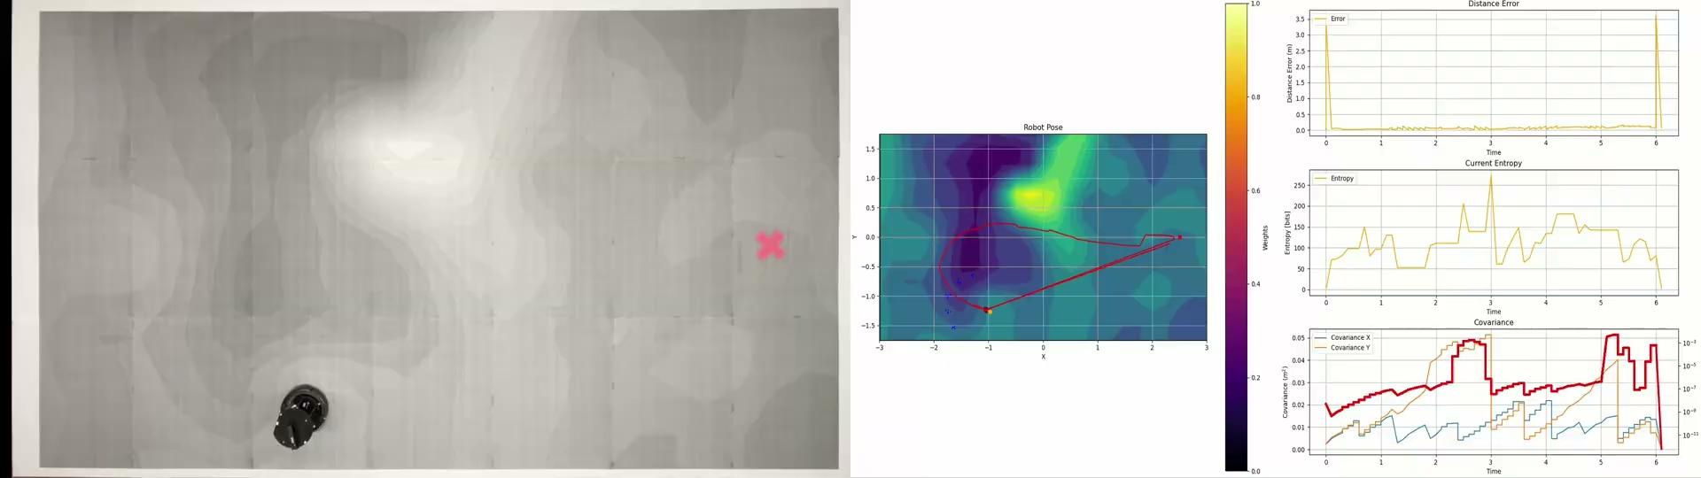
Experiments — Hardware Demonstration

Slide 33
Experiments — Hardware Results
The hardware experiments inform us about the methods robustness to changing environments
The Graph method outperforms all others, but InfoMagNav is not significantly worse compared to the SoTA DPSolver.
Algorithm | Tr. Statistical Cov (m) ↓ | Completion Rate (%) ↑
Baseline Methods
Graph | 0.0188 | 100
MPC Goal Con. | 0.0262 | 100
Information Driven Methods
DPSolver | 0.0546 | 70
InfoMagNav | 0.0217 | 100

Slide 34
Conclusions and Limitations

Slide 35
Conclusions
Presented a information theoretic approach to navigation in magnetic anomalies
  The method applies an estimation to probabilistic state uncertainty to produce a calibrated uncertainty propagation with reduction.
The method presented is significantly more robust and computationally efficient than the state of the art.
Statistically and hardware validated the method to show robustness in different maps.

Slide 36
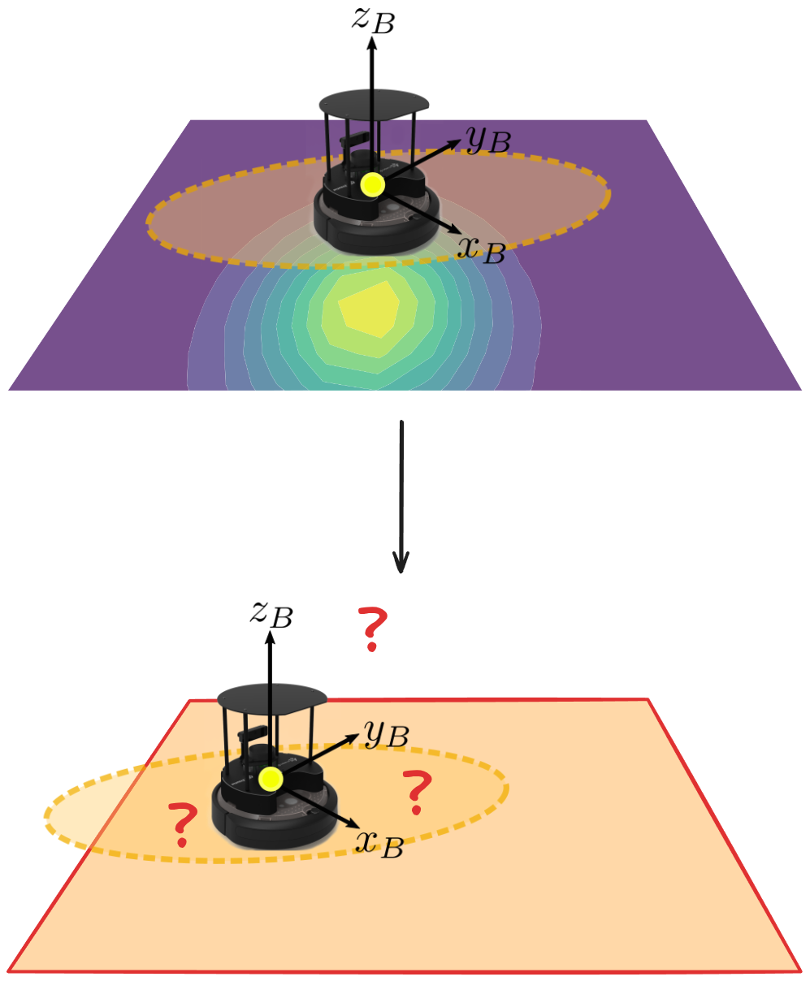
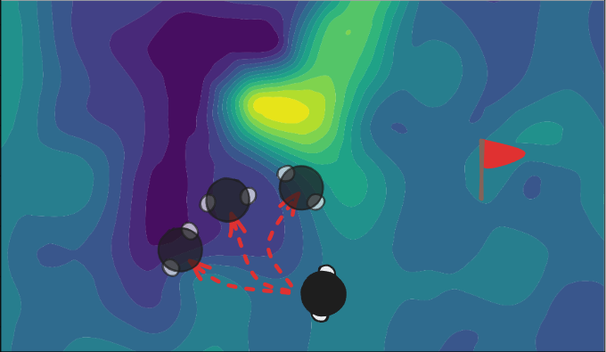
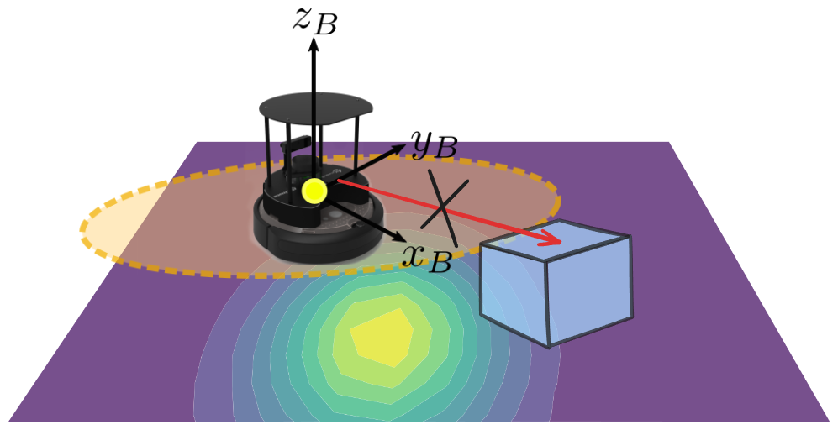
Limitations
Map Dependence
Short Horizon Navigation
Obstacle Detection
Fig. 11: Limitations of the presented method
The system is completely reliant on the map for localization and navigation
The system is bound to short horizon actions to optimize over
MagNav cannot inherently detect any objects that were not mapped

