Slide 1


Particle Filters
April 5, 2024
Aditya Penumarti

Slide 2
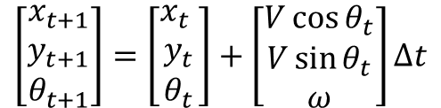

Particle Filter Preliminaries: Motion Model
The motion model predicts the state into the future. The unicycle kinematics is best for robots with a differential drive system, like a Roomba!
$$u_{t}={\left[V,ω\right]}^{T}$$
$$\left[\begin{matrix}x_{t+1} \\ y_{t+1} \\ θ_{t+1}\end{matrix}\right]=\left[\begin{matrix}x_{t} \\ y_{t} \\ θ_{t}\end{matrix}\right]+\left[\begin{matrix}V\cos{θ_{t}} \\ V\sin{θ_{t}} \\ ω\end{matrix}\right]Δt$$
Figure 1. Unicycle Kinematics

Slide 3
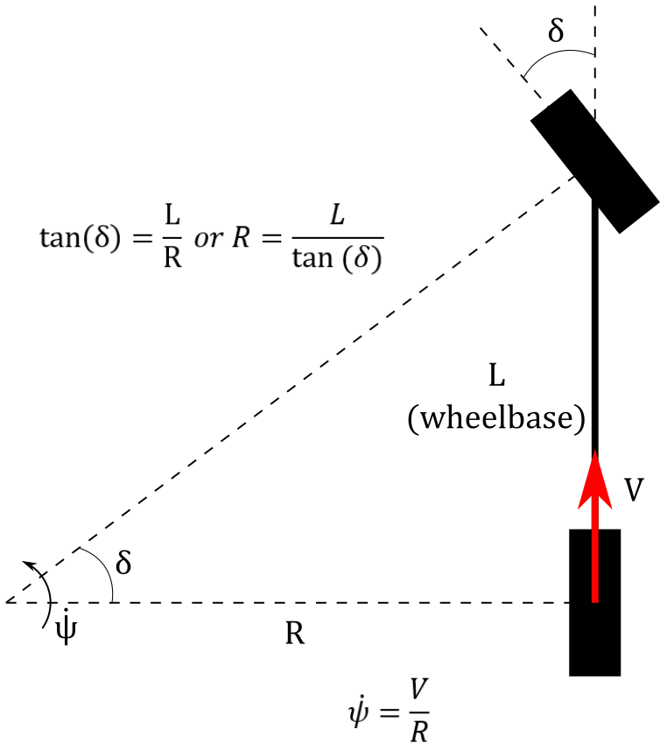
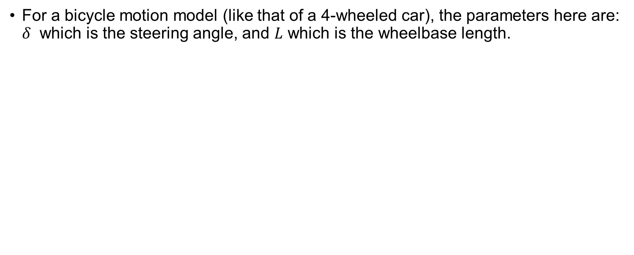
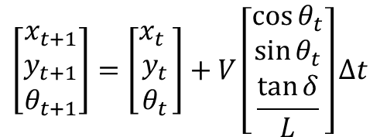
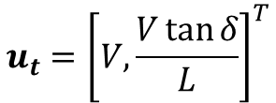
Particle Filter Preliminaries: Motion Model
For a bicycle motion model (like that of a 4-wheeled car), the parameters here are: $δ$ which is the steering angle, and $L$ which is the wheelbase length.
$$u_{t}={\left[V,\frac{V\tan{δ}}{L}\right]}^{T}$$
$$\left[\begin{matrix}x_{t+1} \\ y_{t+1} \\ θ_{t+1}\end{matrix}\right]=\left[\begin{matrix}x_{t} \\ y_{t} \\ θ_{t}\end{matrix}\right]+V\left[\begin{matrix}\cos{θ_{t}} \\ \sin{θ_{t}} \\ \frac{\tan{δ}}{L}\end{matrix}\right]Δt$$
Figure 2. Bicycle Kinematics

Slide 4

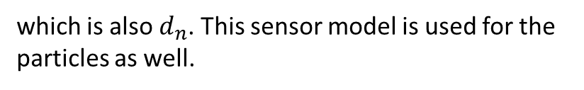

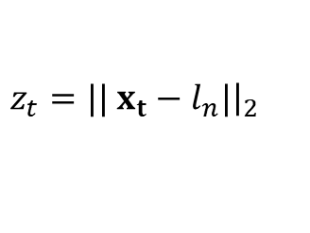
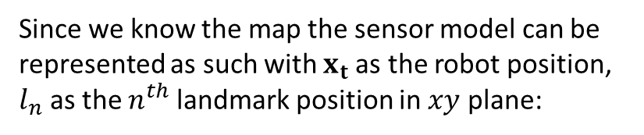

Particle Filter Preliminaries: Sensor Model
The sensor model for a particle filter is important to calculate the weights. Here in this toy example a distance to landmark sensor is used. This sensor provides a scalar distance between the robot and the landmark
Since we know the map the sensor model can be represented as such with $x_{t}$as the robot position, $l_{n}$ as the $n^{th}$ landmark position in $xy$ plane:
Landmark 1
$$d_{1}$$
$z_{t}=||$ $x_{t}−l_{n}|{\left.​\right|}_{2}$
which is also $d_{n}$. This sensor model is used for the particles as well.
$$d_{2}$$
Landmark 2
Robot
$$d_{3}$$
Landmark 3
Figure 3. Sensor Model

Slide 5
On to Filtering!

Slide 6
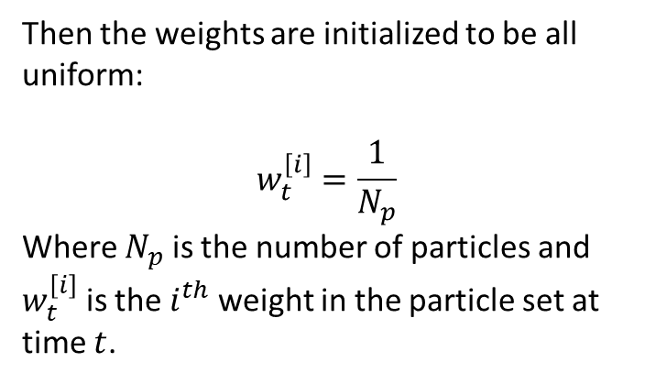
Particle Filter Initialization
First the particles must be initialized. Here we are going to initialize a Gaussian around an initial guess of the robots pose (The particles can also be uniformly initialized). Effectively, we take the particles starting at the robots pose, and randomly distort the particles within a certain radius.
Then the weights are initialized to be all uniform:
$$w_{t}^{\left[i\right]}=\frac{1}{N_{p}}$$
Where $N_{p}$ is the number of particles and $w_{t}^{\left[i\right]}$ is the $i^{th}$ weight in the particle set at time $t$.
Figure 4. Particle Initialization

Slide 7
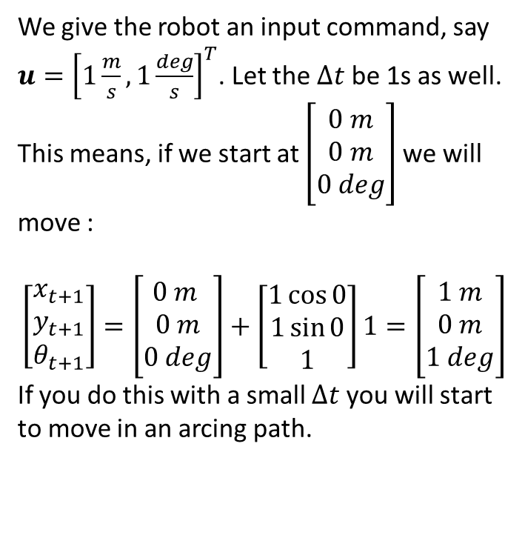
Particle Filter Prediction
Then we can predict the particles. This prediction is performed by using the motion model.
We give the robot an input command, say $u={\left[1\frac{m}{s}, 1\frac{deg}{s}\right]}^{T}$. Let the $Δt$ be 1s as well. This means, if we start at $\left[\begin{matrix}0 m \\ 0 m \\ 0 deg\end{matrix}\right]$ we will move :
$$\left[\begin{matrix}x_{t+1} \\ y_{t+1} \\ θ_{t+1}\end{matrix}\right]=\left[\begin{matrix}0 m \\ 0 m \\ 0 deg\end{matrix}\right]+\left[\begin{matrix}1\cos{0} \\ 1\sin{0} \\ 1\end{matrix}\right]1=\left[\begin{matrix}1 m \\ 0 m \\ 1 deg\end{matrix}\right]$$
If you do this with a small $Δt$ you will start to move in an arcing path.
Figure 5. Predict Step

Slide 8
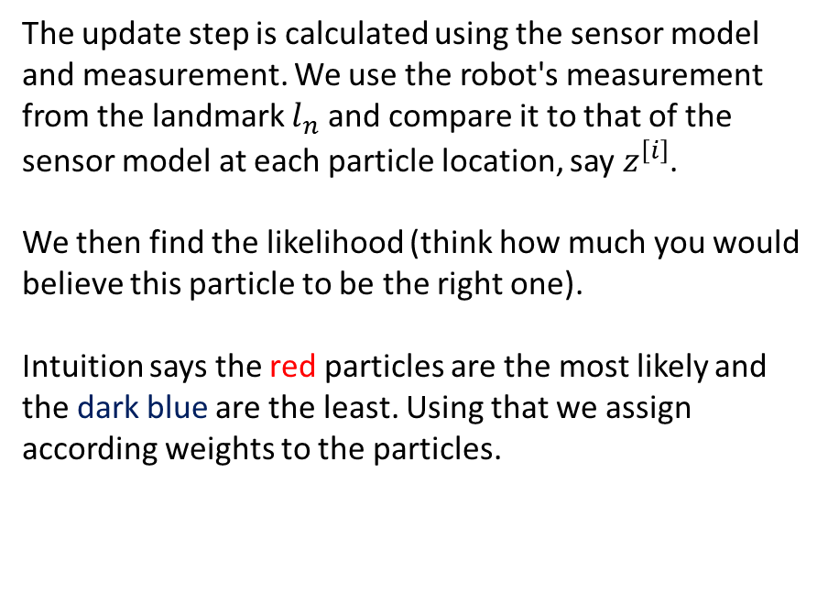
Particle Filter Update
Remember now the weights are still uniform. We want to tell the filter that some of the state guesses are not good anymore, or some of them are much better.
The update step is calculated using the sensor model and measurement. We use the robot's measurement from the landmark $l_{n}$ and compare it to that of the sensor model at each particle location, say $z^{\left[i\right]}$.
We then find the likelihood (think how much you would believe this particle to be the right one).
Intuition says the red particles are the most likely and the dark blue are the least. Using that we assign according weights to the particles.
Figure 5. Update Step

Slide 9
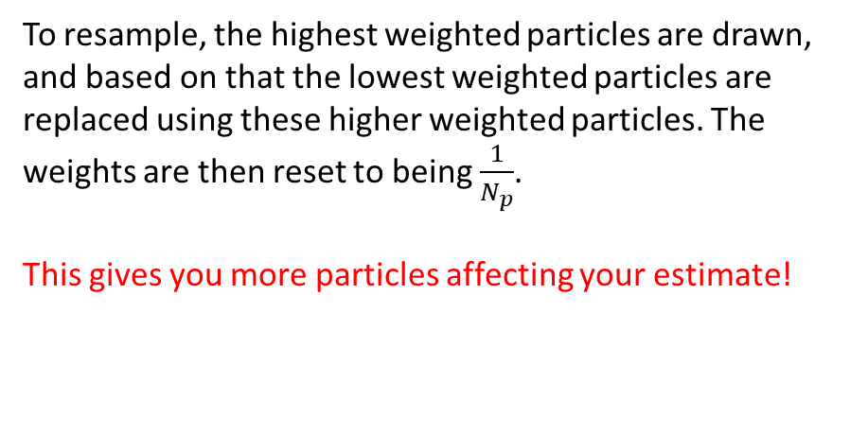
Particle Filter Resample
Now say the particles get really spread out, and you have mostly blue particles and one red particle. This is when the particles have been degenerated and need to be resampled
To resample, the highest weighted particles are drawn, and based on that the lowest weighted particles are replaced using these higher weighted particles. The weights are then reset to being $\frac{1}{N_{p}}$.
This gives you more particles affecting your estimate!
Figure 5. Resample Step

Slide 10
Particle Filter Estimate
Using the weights and the particles an estimate can be formed. This is effectively just taking the weighted mean of all the guesses and getting an approximate estimated state of the robot
Figure 5. Estimate

Slide 11
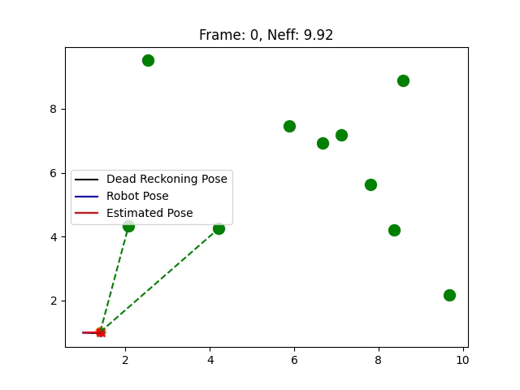
Particle Filter Toy Example
Now using all we have learned, let’s try a toy example.
CoLab Link:
https://colab.research.google.com/drive/1cxYa0lfiL-9oqd-kkGMMXUZMvD2n1-0C?usp=sharing
TinyURL Link:
https://tinyurl.com/ycyd3kae

